Slide 1
Youtube’s Trending videos analysis
Presented by
Chithra
Koffi

Slide 2
Introduction...
YouTube’s trending videos vary by location across the world. Here is quick analysis on channel's watch time, views or earning….

Slide 3
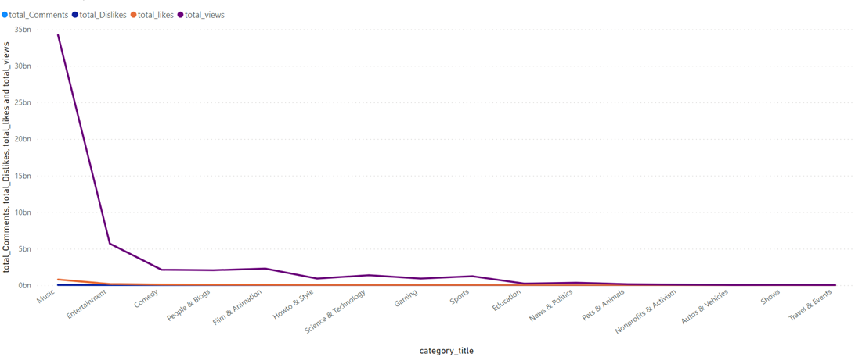
Impact of Likes,dislikes and comments on views
Views Trend declines after Entertainment.
Views are mostly affected by “Likes” “ and Comment count”

Slide 4
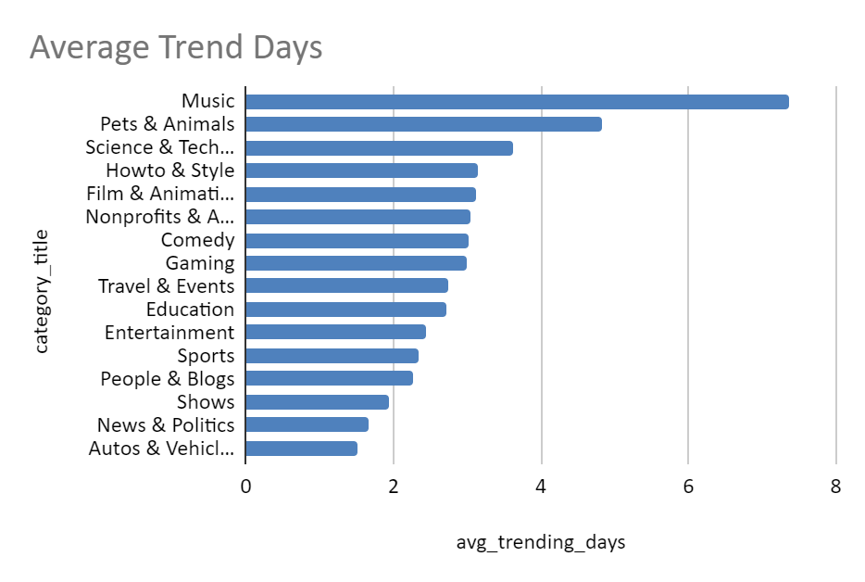
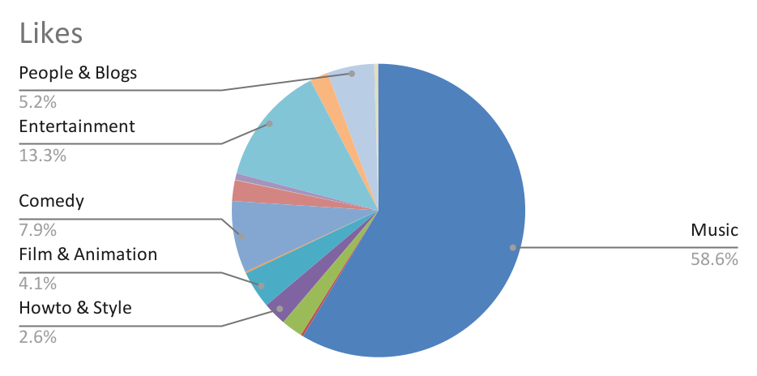
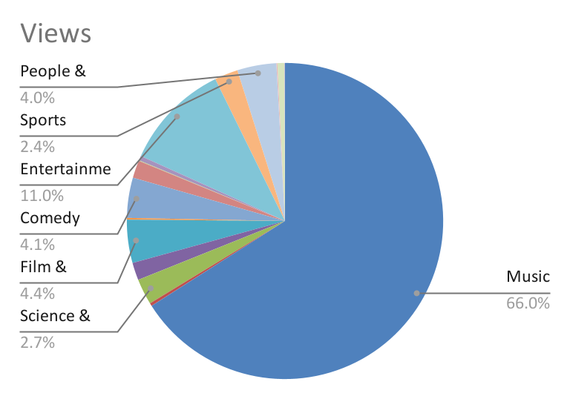
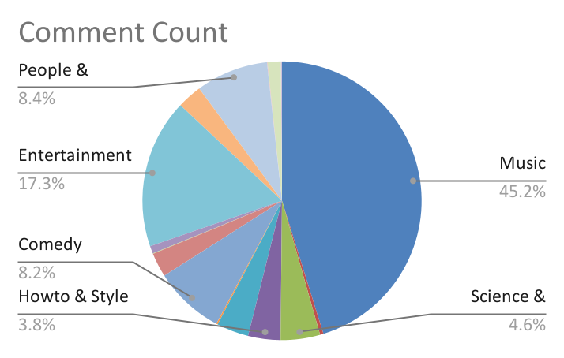
More Likes ->More Comments - >More Video Views
Music
Travel & Events
Refreshment Categories-Music,Entertainment,comedy
Knowledge Based Categories

Slide 5
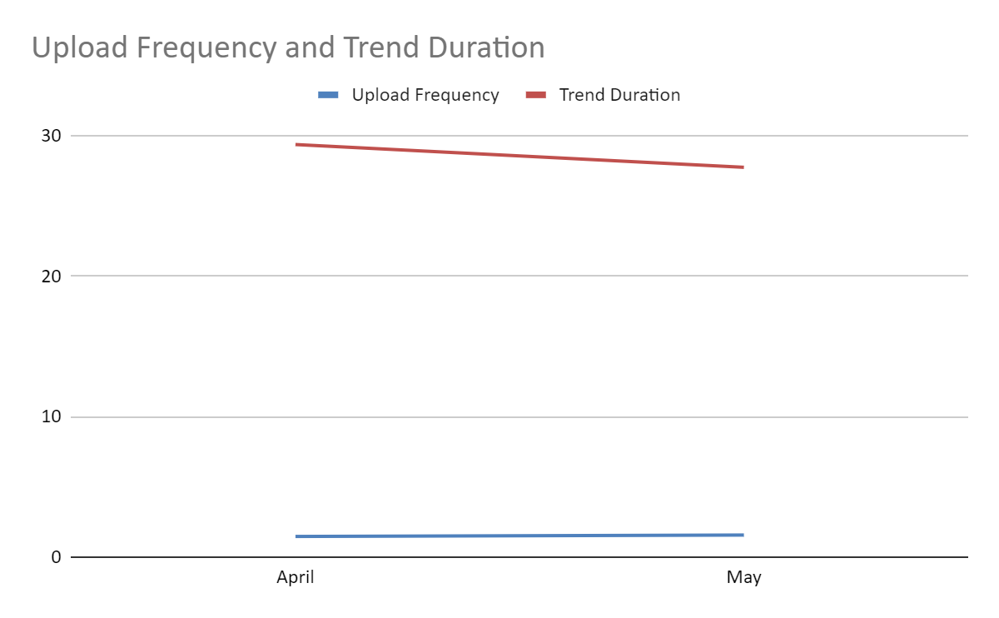
Channel Level Analysis
Upload Frequency
Trend Duration

Slide 6
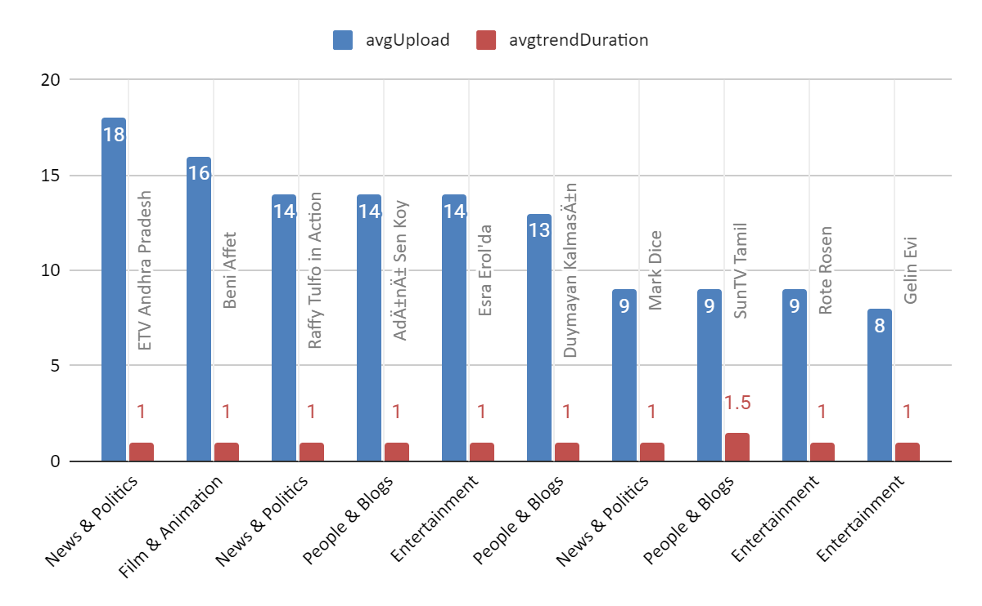
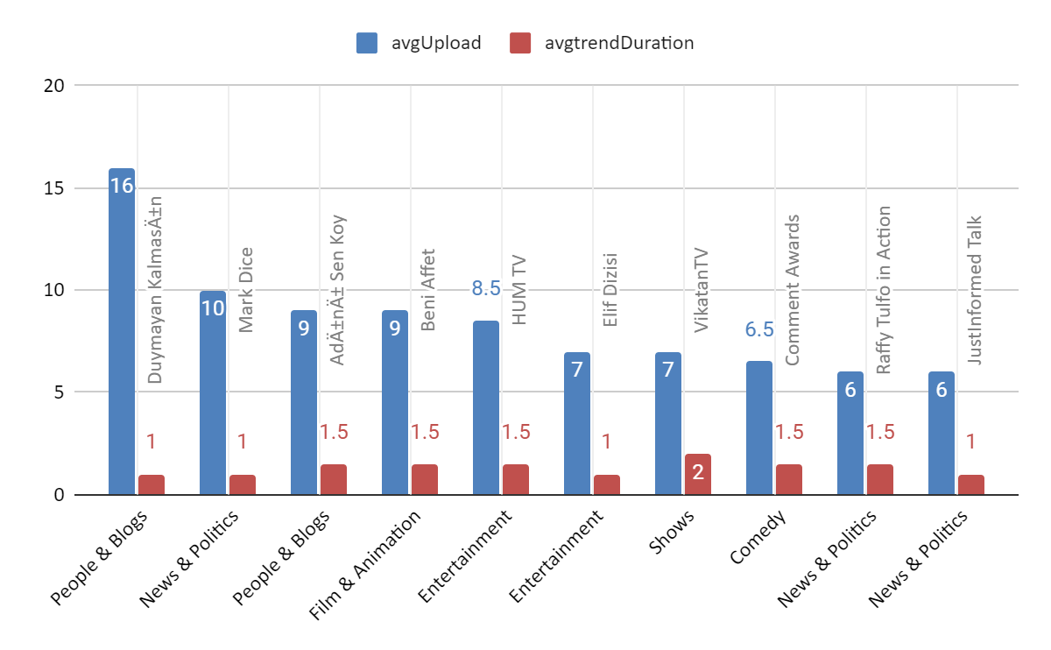
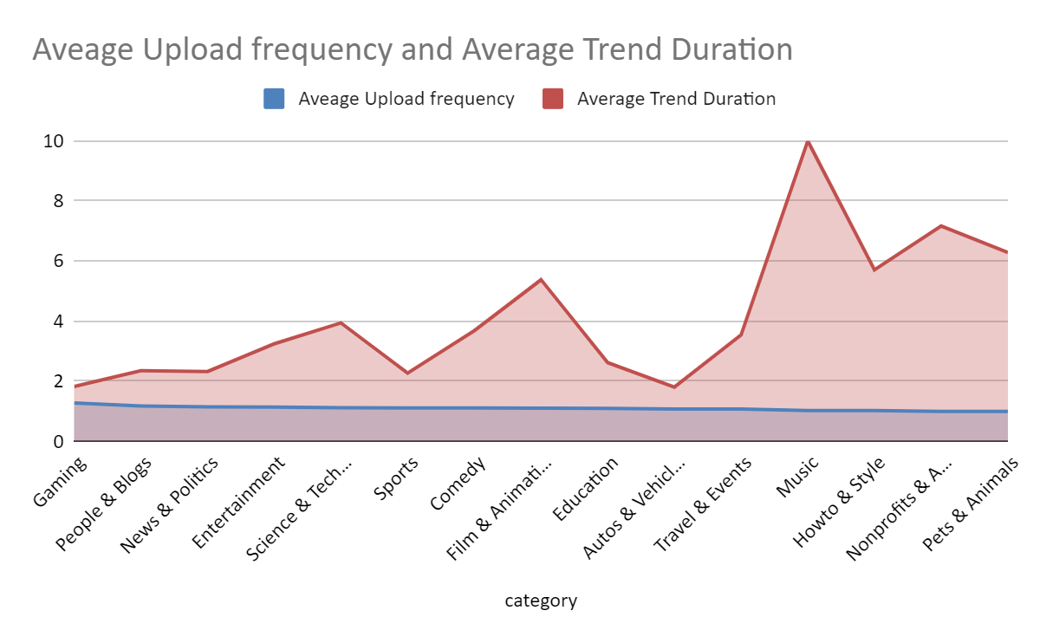
Channel Level Analysis
April
May
April
May
Channels with only April Data
Some Channels do not upload data consistently every month .

Slide 7
Insights..
Channels should maintain the upload schedule for gaining the high views and trend duration
Drop in video with high watch time should be avoided.

Slide 8
Thank You

